Slide 1
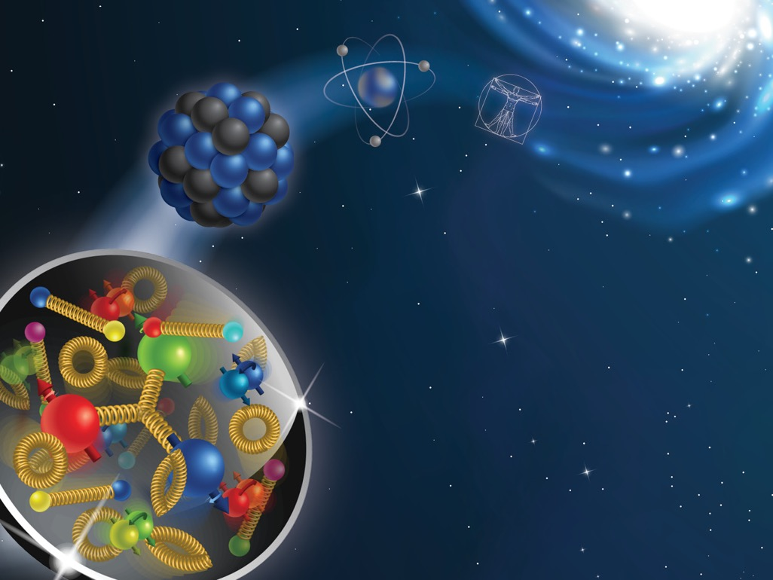
Phenomenology of TMDs: lecture I
Alexei Prokudin

Slide 2
The plan:
Lecture I:
Structure of the nucleon
Transverse Momentum Dependent distributions (TMDs)
Lecture II
Semi Inclusive Deep Inelastic Scattering (SIDIS)
Calculations of SIDIS structure functions using Mathematica
You will find all material in https://github.com/prokudin/Cagliari22
There are 4 exercises:
Choose any file sivers.nb, collins.nb, or boermulders.nb. Follow the file, calculate the structure functions and plot the asymmetries. Compare your results to plots from example.nb
** Use the definitions of Fourier transforms of TMDs from the TMD handbook Eq. (2.192), (2.193) and show that they give the same results as the ones you obtain in the previous exercise

Slide 3
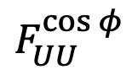
The plan:
Lecture I:
Structure of the nucleon
Transverse Momentum Dependent distributions (TMDs)
Lecture II
Semi Inclusive Deep Inelastic Scattering (SIDIS)
Calculations of SIDIS structure functions using Mathematica
You will find all material in https://github.com/prokudin/Cagliari22
There are 4 exercises:
*** Rewrite the notebooks using Python, SymPy https://www.sympy.org/en/index.html to perform analytical computations
*** Use the mathematica notebook, implement numerically the constraints on the partonic transverse momenta from https://inspirehep.net/literature/916578 and compare results on
$$F_{UU}^{\cos{φ}}$$

Slide 4
What do we study?

Slide 5
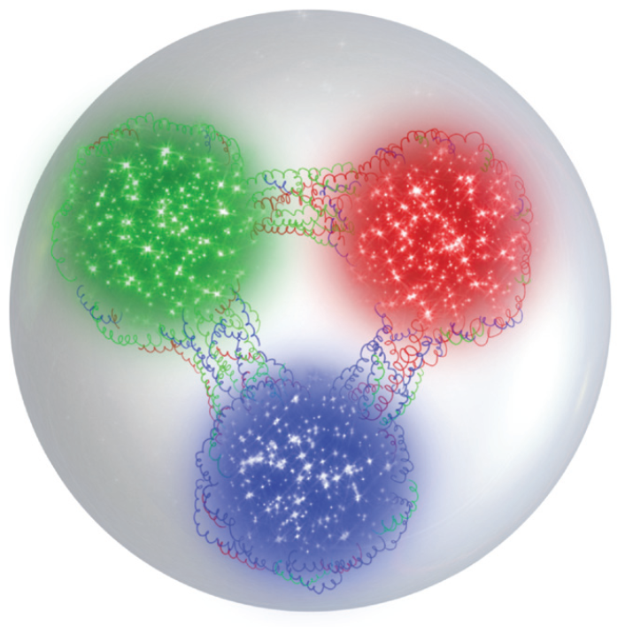
Quark model
Proton
Two “up”
one “down”
u
u
d
Neutron
Two “down”
one “up”
d
d
u

Slide 6
Quark model
Proton
Charge
2/3 + 2/3 -1/3 = +1
u
u
Quark charges
are fractional
of positron’s charge
d
Neutron
2/3 - 1/3 -1/3 = 0
d
d
Quarks are
bound (confined)
by strong interaction
(gluons)
u

Slide 7
Quark model
Proton
Charge
No evidence of free quarks
observed directly in experiment
2/3 + 2/3 -1/3 = +1
u
u
Quark charges
are fractional
of positron’s charge
Long distance - quarks
are confined in hadrons
d
Short distance - quarks
behave as if they were free
Neutron
2/3 - 1/3 -1/3 = 0
Asymptotic freedom -
later in this lecture!
d
d
Quarks are
bound (confined)
by strong interaction
(gluons)
u

Slide 8
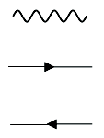
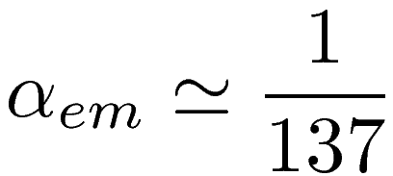
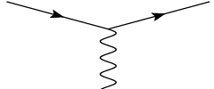
Quantum Electro Dynamics and Quantum Chromo Dynamics
QED
Gauge theory U(1)
Force carrier:
photon (electrically neutral)
u
u
electron
d
positron
Interaction
d
d
u

Slide 9
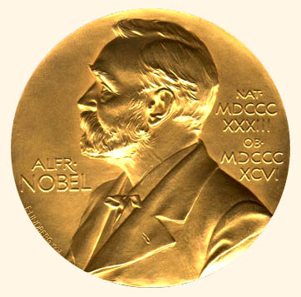
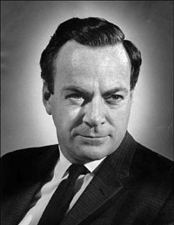
Quantum Electro Dynamics and Quantum Chromo Dynamics
QED
Gauge theory U(1)
Force carrier:
photon (electrically neutral)
u
u
electron
d
positron
Interaction
d
d
Richard Feynman, Nobel Prize 1965
u
“for ... fundamental work in
quantum electrodynamics"

Slide 10

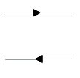
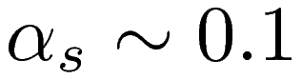
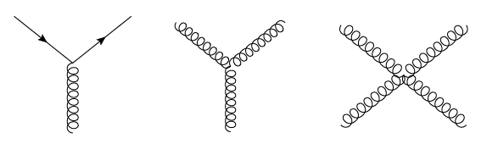
Quantum Electro Dynamics and Quantum Chromo Dynamics
QED
QCD
Gauge theory U(1)
Gauge theory SU(3)
Force carrier:
photon (electrically neutral)
Force carriers:
gluons (carry color)
u
u
electron
quark
d
positron
anti-quark
Interaction
Interaction
strong
d
d
Richard Feynman, Nobel Prize 1965
u
Gluons interact with each other
- non abelian theory
“for ... fundamental work in
quantum electrodynamics"

Slide 11
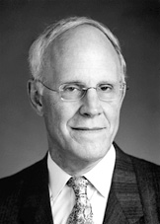
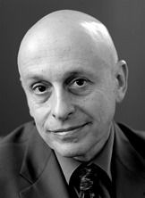
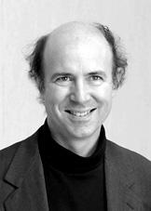
Asymptotic freedom
The coupling depends
on the scale – consequence of
renormalizability of the theory
At short distances
quarks behave as if they were
almost free particles!
“long” DISTANCE “short”
“for the discovery of asymptotic freedom
in the theory of the strong interaction"
Gross, Politzer, Wilczek, Nobel Prize 2004
Notes:
Now more the deep inelastic view, the mess inside the nucleon, note the Z exchange.
Note the Nobel Prizes pretty much attributable to this picture.
Test
11

Slide 12
How do we study the structure?

Slide 13
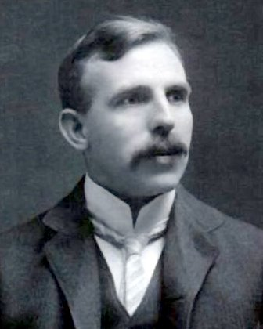
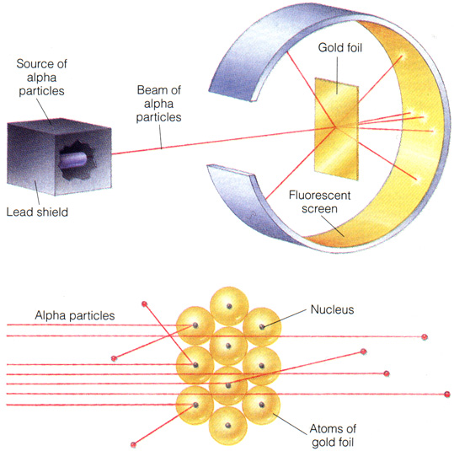
Scattering as the method of study
“for his investigations into the disintegration of
the elements, and the chemistry of radioactive
substances"
Ernest Rutherthord, Nobel Prize 1908
1911
Notes:
Now more the deep inelastic view, the mess inside the nucleon, note the Z exchange.
Note the Nobel Prizes pretty much attributable to this picture.
Test
13

Slide 14
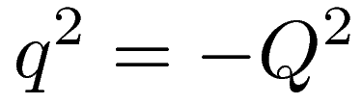

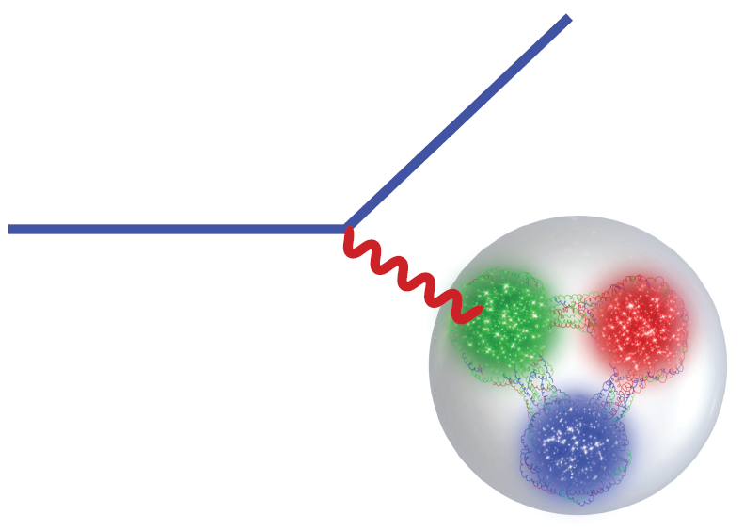
Electron Scattering
Detector of electrons
Virtuality of the photon
scattered electron
electron
photon
Detector of
hadrons
Notes:
Now more the deep inelastic view, the mess inside the nucleon, note the Z exchange.
Note the Nobel Prizes pretty much attributable to this picture.
Test
14

Slide 15
Electron Scattering
Detector of electrons
Virtuality of the photon
scattered electron
electron
photon
The photon probes
transverse distance of ~1/Q
inside of the proton.
Asymptotic freedom -
photon scatters off a quark
Detector of
hadrons
Notes:
Now more the deep inelastic view, the mess inside the nucleon, note the Z exchange.
Note the Nobel Prizes pretty much attributable to this picture.
Test
15

Slide 16
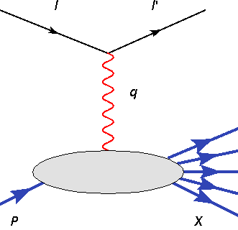
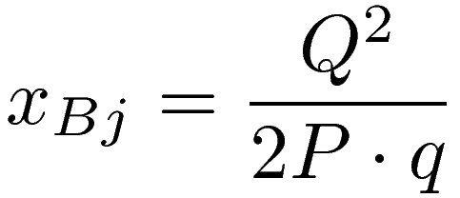
Electron Scattering: interpretation
Electromagnetic probe resolves a quark
or anti-quark with momentum p=xP
inside of the proton of momentum P.
Bjorken variable
Gives the fraction of longitudinal
momentum of the proton carried
by the parton
Notes:
Now more the deep inelastic view, the mess inside the nucleon, note the Z exchange.
Note the Nobel Prizes pretty much attributable to this picture.
Test
16

Slide 17
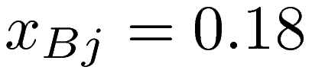
Electron Scattering: interpretation
Experimental data
Behavior is almost flat
– quarks are pointlike
Notes:
Now more the deep inelastic view, the mess inside the nucleon, note the Z exchange.
Note the Nobel Prizes pretty much attributable to this picture.
Test
17

Slide 18
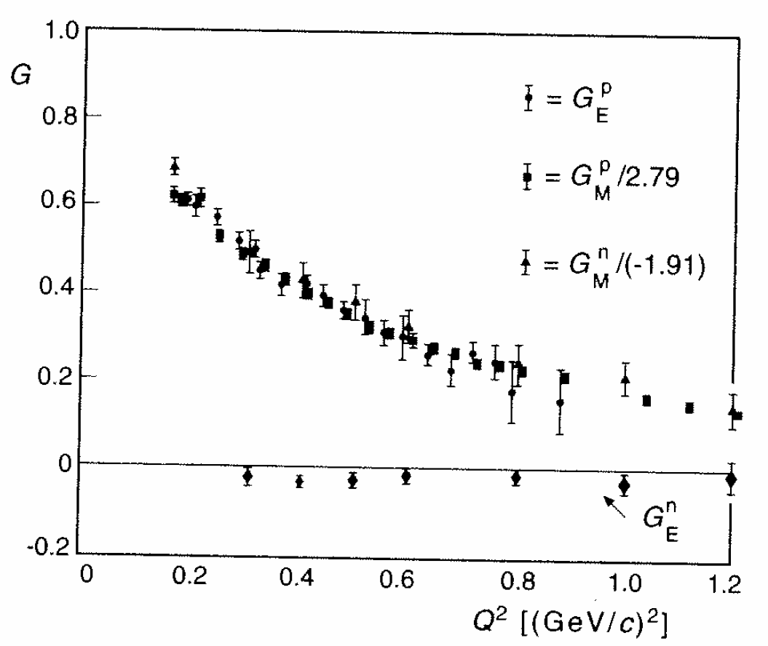
Electron Scattering: interpretation
Unlike the proton itself:
Proton size ~ 1 fm
Notes:
Now more the deep inelastic view, the mess inside the nucleon, note the Z exchange.
Note the Nobel Prizes pretty much attributable to this picture.
Test
18

Slide 19
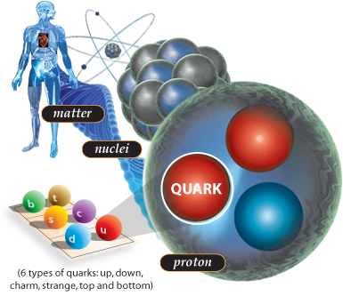

Exploring the nucleon: a fundamental quest
Know what we
are made of !
Understand the
strong force:
“QCD”
Use protons as tool
for discovery
(e.g. LHC )

Slide 20
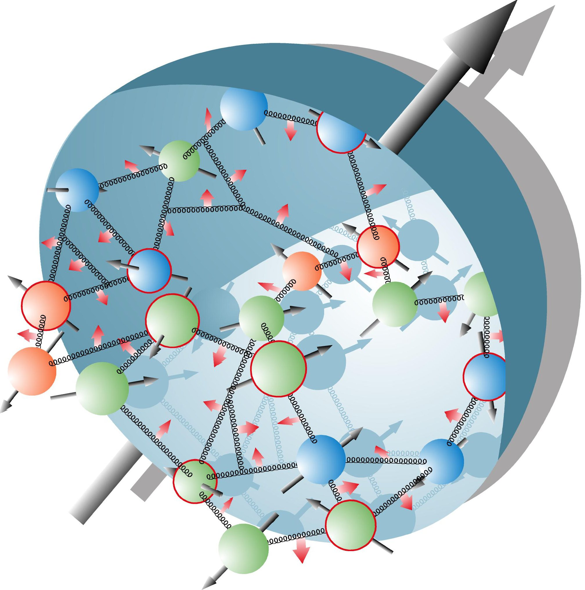
Why Spin?
Xiangdong Ji at DIS08
Spin is a fundamental quantum degree of freedom
Spin plays a critical role in
determining the basic structure
of fundamental interactions
Test of a theory is not complete
without a full test of spin-dependent
decays and scattering
Spin provides a unique opportunity to probe
the inner structure of a composite system
(such as the proton)

Slide 21
Spin and QCD
“Experiments with spin have killed more theories than any other single physical parameter”
Elliot Leader, Spin in Particle Physics, Cambridge U. Press (2001)
“Polarization data has often been the graveyard of fashionable theories. If theorists had their way they might well ban such measurements altogether out of self-protection.”
J. D. Bjorken, Proc. Adv. Research Workshop on QCD Hadronic Processes, St. Croix, Virgin Islands (1987).

Slide 22
The nucleon landscape

Slide 23
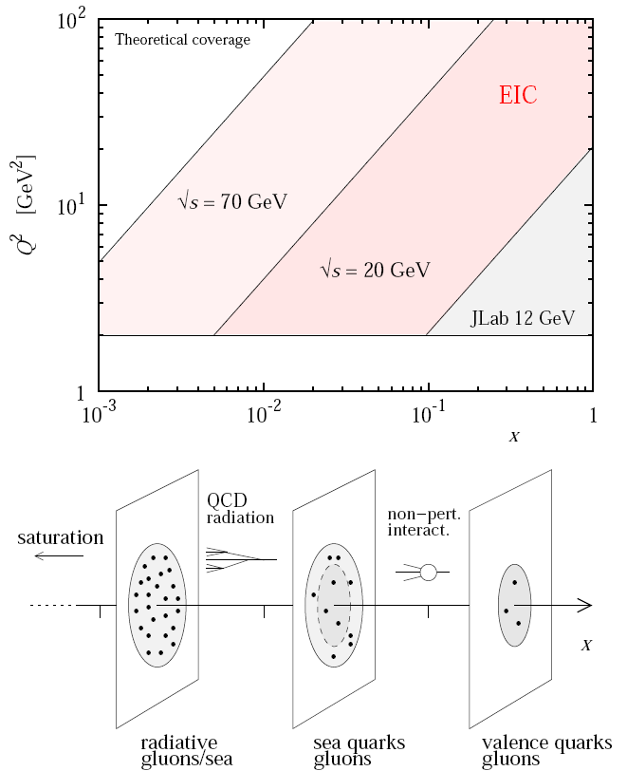
Nucleon landscape
Nucleon is a many body dynamical system of quarks and gluons
Changing x we probe different aspects of nucleon wave function
How partons move and how they are
distributed in space is one of the directions of development of nuclear physics
Technically such information is encoded into Generalised Parton Distributions (GPDs) and
Transverse Momentum Dependent distributions (TMDs)
These distributions are also referred to as 3D (three-dimensional) distributions

Slide 24
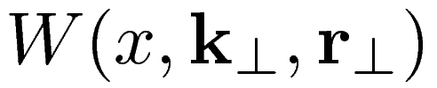
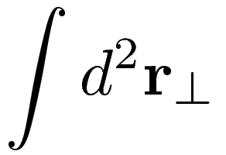
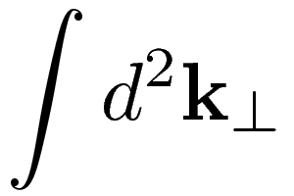
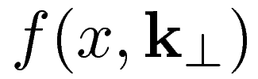
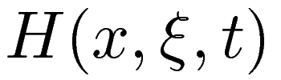
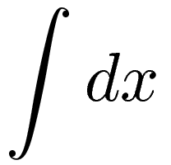
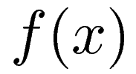
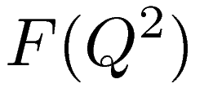
Unified View of Nucleon Structure
5D
Wigner function
Transverse
Momentum
Dependent
distributions
Generalized
Parton
Distributions
3D
Parton
Distribution
Functions
Form
Factors
1D
Alexei Prokudin

Slide 25
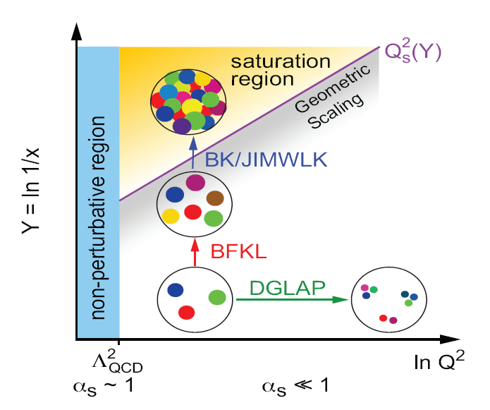
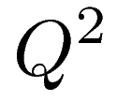
Nucleon landscape
Virtual photon serves as a microscopic probe of the nucleon:
Larger probe smaller distances –
DGLAP evolution
Plot from EIC whitepaper

Slide 26
Nucleon landscape
Virtual photon serves as a microscopic probe of the nucleon:
Fixing and changing the energy we probe BFKL evolution
Plot from EIC whitepaper

Slide 27
Nucleon landscape
Virtual photon serves as a microscopic probe of the nucleon:
Recombination of gluons leads to non linear effects – BK/JIMWLK evolution and phenomenon of saturation. Dilute vs dense regime of QCD.
Plot from EIC whitepaper

Slide 28
Nucleon landscape
Factorization theorems help us to relate functions that describe the hadron structure and the experimental observables
Factorization is a controllable approximation and the goal of theorists and phenomenologists is to test and improve the region of applicability of factorization and/or construct new factorization theorems
Hadron structure is the ultimate goal of measurements and phenomenology
The polarized proton in momentum
space as “seen” by the virtual photon

Slide 29
How do we study the structure of the nucleon?

Slide 30
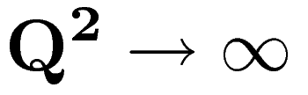
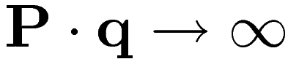
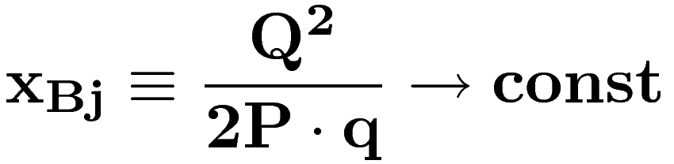
Deep Inelastic Scattering (DIS)
In order to access distributions we could use
deep inelastic scattering
The energy is big enough to
transform the proton in
a lot of final states
Bjorken limit is

Slide 31
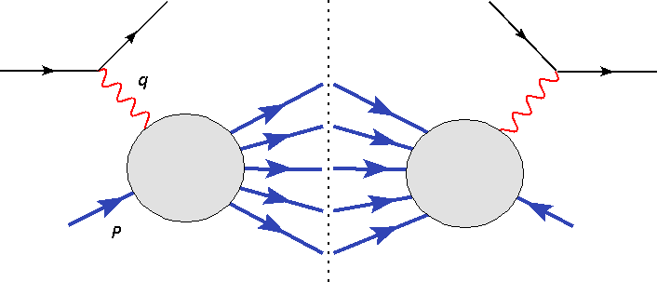
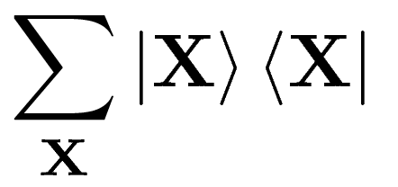
Deep Inelastic Scattering (DIS)
Distributions measured in deep inelastic scattering
This sum makes it sensitive to parton structure!

Slide 32
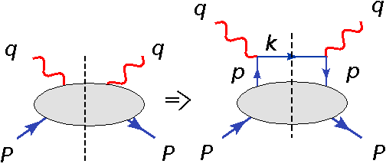
Distributions and parton model
Parton model is a logical step, partons are pointlike and dilute, so the photon interacts with them incoherently

Slide 33
Distributions and parton model
Parton model is a logical step, partons are pointlike and dilute, so photon interacts with them incoherently
CONSTANT!

Slide 34
Factorization
Leptonic tensor
Hadronic tensor
p
p
Notes:
Integration.
Integration over k.
But all components of k small is not in proton.

Slide 35
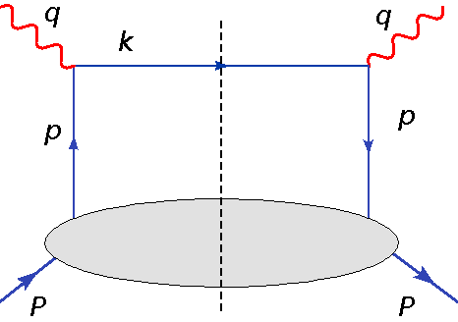
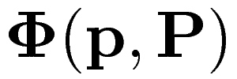
Distributions and parton model
This diagram is called “handbag diagram”
- parton correlator

Slide 36
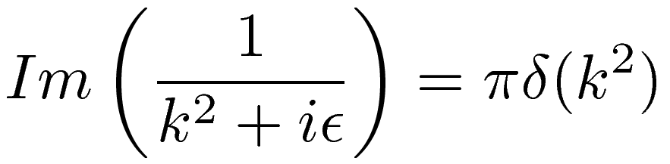
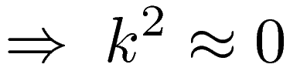
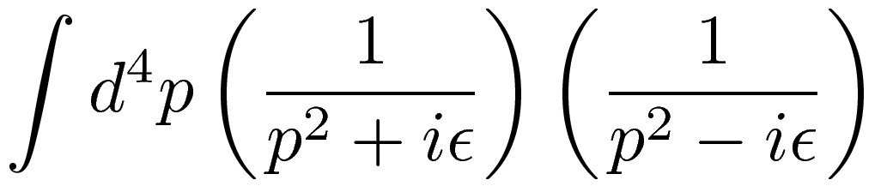
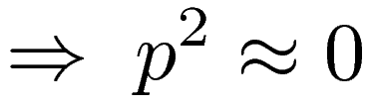
Distributions and parton model
Why quarks are on mass-shell?
This one is virtual! However the main contribution comes from

Slide 37
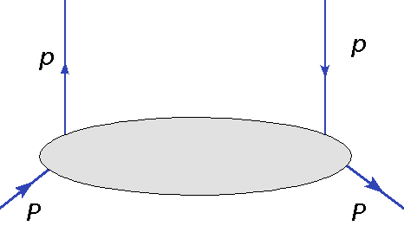
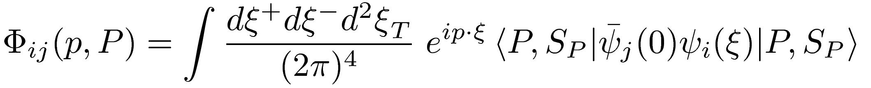
Distributions and parton model
Definition of parton correlator

Slide 38
Distributions and parton model
Definition of parton distribution
Fourier transform from coordinate to momentum space

Slide 39
Distributions and parton model
Definition of parton distribution
Quark field operator

Slide 40
Distributions and parton model
Definition of parton distribution
The proton state vector

Slide 41
Distributions and parton model
Definition of parton distribution
Position of the field in coordinate space

Slide 42
Distributions and parton model
Definition of parton distribution
This matrix element is called “bilocal”

Slide 43
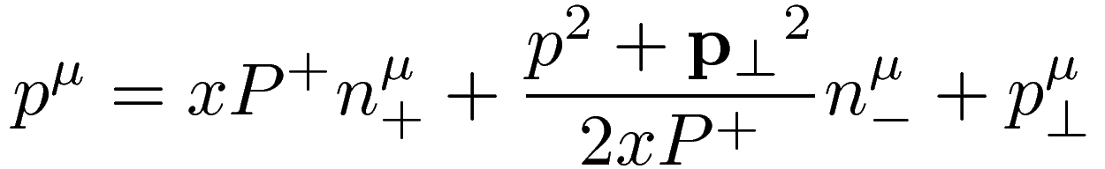





Distributions and parton model
What do we know about quark momentum? Suppose that proton
is moving along Z direction with a high momentum, then
“Big”component
is a new variable called lightcone momentum
fraction

Slide 44

Distributions and parton model
What do we know about quark momentum?
“Big”component
“Small” component

Slide 45

Distributions and parton model
What do we know about quark momentum?
“Big”component
“Small” component
“Transverse” component

Slide 46



Distributions and parton model
What do we know about hadronic tensor?
Quarks are “probed” at value of

Slide 47







Gauge invariance
The quark and the remnant are colored thus they interact
via gluon exchanges! If “–” and perpendicular component of parton momentum are neglected, then in configuration space only “–” component survives,
This object is called Wilson line
For DIS:

Slide 48







Factorization
Distribution

Slide 49

Success of QCD factorization
Universality of PDFs: mapped in one process (say DIS), used in other processes

Slide 50
Success of QCD factorization
Universality of PDFs: mapped in one process (say DIS), used in other process

Slide 51
Success of QCD factorization
Universality of PDFs: mapped in one process (say DIS), used in other process

Slide 52
Success of QCD factorization
Universality of PDFs: mapped in one process (say DIS), used in other process

Slide 53
Let us go beyond collinear picture

Slide 54
Transverse structure: Momentum vs Position
Variables are related by 2-dimensional Fourier transform
At the level of squared amplitudes, one has
The ‘average’ transverse momentum is Fourier conjugate to position difference (TMD)
The momentum transfer is Fourier conjugate to ‘average’ position (GPD)

Slide 55






GPDs TMDs
Kotzinian (1995),
Mulders,
Tangerman (1995),
Boer, Mulders (1998)
DVCS
Ji (1997)
Radyushkin (1997)
SIDIS
Imaginary part, momentum transfer is zero
ensures hard scale, pointlike interaction
ensures hard scale, pointlike interaction
momentum transfer can be varied
independently
final hadron transverse momentum
can be varied independently
Connection to 3D structure
Burkardt (2000)
Burkardt (2003)
Ji, Ma, Yuan (2004)
Collins (2011)
Connection to 3D structure
is the transverse separation of parton fields
in configuration space
Drell-Yan frame
Weiss (2009)
AP (2012)

Slide 56





Transverse Momentum Dependent distributions
Gauge link
Ensures gauge invariance of
the distribution, cannot be canceled by gauge choice
SIDIS in IMF:
Struck quark

Slide 57
Transverse Momentum Dependent distributions
Individual TMDs can be projected out of the correlator
Unpolarized quarks
Longitudinally polarized quarks
Transversely polarized quarks

Slide 58
TMD distributions
8 functions in total (at leading
twist)
Each represents different aspects of partonic structure
Each depends on Bjorken-x, transverse momentum, the scale
Each function is to be studied
Kotzinian (1995), Mulders, Tangerman (1995), Boer, Mulders (1998)

Slide 59
TMD distributions
8 functions in total (at leading
twist)
Each represents different aspects of partonic structure
Each depends on Bjorken-z, transverse momentum, the scale
Each function is to be studied
Kotzinian (1995), Mulders, Tangerman (1995), Boer, Mulders (1998)

Slide 60
TMD distributions
More at higher twist!

Slide 61
TMD distributions
More at higher twist!
STAMP COLLECTING?

Slide 62

We are in a good company

